Slide 1
Towards More Agile and Inexpensive Robotics
Darren Levine

Slide 2
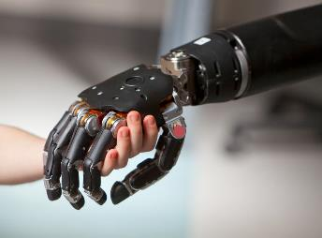
Current Progress In Agile Robotics
Motivations:
Medical care, Emergency scenarios, Advancements in prosthetics/transhumanism
Advances in manufacturing, liberation from menial/dangerous labor
Already many specialized robotics systems, 3D printers, Roombas, etc.
Emerging fields: Soft robotics, Foldable Robotics
Why Focus on Agility?
Common capability needed for human like generalization / fluid action
Systems have a hard time generalizing, a system built for one task will not perform at another
Interacting in a world built for the human form
→ Humanoid Robotics, Legged Robotics
→ Moving towards/past “Human Like” Capabilities
Why Focus on Cost?
Low Proliferation: Specialization and niche markets
Slow development, limited access to software/hardware
State of the art in agile humanoid robotics ( >> $1M)
Boston Dynamics Atlas, & Handle
Honda Asimo & E2-DR, Nasa Valkyrie, Toyota T-HR3
DRC-Hubo won the 2015 DARPA challenge
Still a high degree of Teleoperation / Scripted Action
DARPA Neurally Controlled Prosthetic
Atlas 2017 (2/3 of human time)
Cost
Superhuman
0 0.3 0.6 1/1 1.3
Execution Time Compared to a Human for Non-Specialized Tasks
Why is this problem difficult, and what are potential solutions?

Slide 3
Before we discuss the problem…
Boston Dynamics: Atlas-11/16/2017

Slide 4
Breaking Down Tasks in Robotics
Develop High Level Motivation
Clean a Room, Fly a Mission Route, etc.
Represent the problem / Learn
Knowledge representation framework
Generate a Goal/Dependency Tree
Search and optimization for relevant dependencies
Step Through each Action
Utilize a Control System, example: Visual Servoing
Each of step requires multiple interfaces with environment, errors propagate
Generalizable
Typically done by a human
Has knowledge or an ability to obtain knowledge
Knowledge of Reasoning, Cause and Effect
Highly Specific, Sometimes Scripted
Hardware Modeling
Environmental Modeling
Planning
Physical Contact
Computer Vision
Lidar, Other Sensors…
Software
Robot
World
What we want to happen
What actually happens
Inherently Unstable, Expensive, Multidisciplinary Problem, Cascading Levels of Complexity!

Slide 5
Example: Classical Deductive Chain Approach
Develop High Level Motivation
Clean a Room, Fly a Mission Route, etc.
Represent the problem / Learn
Knowledge representation framework
Generate a Goal/Dependency Tree
Search and optimization for relevant dependencies
Step Through each Modularized Action:
Put X in Y
X=trash, Y=bin
What a X/Y looks like, how to navigate through Z, What the action “Put” means with X in relation to Y
1) Locate Y in Z
2) Navigate to Y
3) “Put” X in Y
Self Localization
SLAM/Computer Vision
Recognize Bin
Computer Vision
Locate Bin
Relative to Self
Computer Vision/
Geolocation Math
Visually Servo to XYZ Position Above Bin
Encoders/INS
Release Trash Above Bin
Control System, model of how trash will fall
Compounding Errors
This works (sometimes)! And the flow of deduction is easy to understand.
Apparent problems with this approach:
Not executed as a fluid action.
Often much slower than a human, each step is elaborate and needs dedicated processing time.
Compounding errors often need error loop closure to route through a long action chain.
Hand designed and requires a lot of processing power
Emergent Behavior is hard to come by (behavior is not easily generalizable to other tasks)

Slide 6
Do humans approach tasks this way?
Sergey Levine’s thought experiment to assess modern robotics:
Given two simple tasks:
Open a door and walk through it
Open a door and walk through it while blindfolded
Result: A human completes the task ~7x faster (even when blindfolded) than a 2015 DARPA challenge humanoid robot.

Slide 7
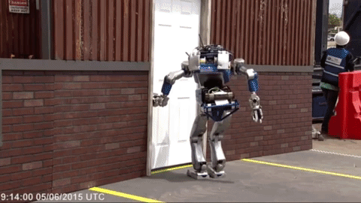
Do humans approach tasks this way?
Sergey Levine’s thought experiment to assess modern robotics:
Given two simple tasks:
Open a door and walk through it
Open a door and walk through it while blindfolded
Result: A human completes the task ~7x faster (even when blindfolded) than a 2015 DARPA challenge humanoid robot.
The robots often fail when not in a controlled environment

Slide 8
Hypothesis as to why the robot is slow
Sensory: If the robot had force feedback, vision, it’d do the task just as well
Emerging robots often do have these senses
Note: The human still completed the task while blindfolded
Hardware: The robot simply can’t move as fast, a hardware limitation
Often they can move faster. (Though latency/ real-time control can be an issue)
Software/Processing: Better software (planning algorithms, computer vision, etc.) would enable superhuman speeds
Seems likely.
So how do we get there?
And is the classic modular deductive chain approach the best way? Or does changing how information flows through the task pipeline provide a benefit.
Asking the robot designer why:
Safety: A slower robot helps keep the robot & handler safe (even humans make mistakes, but we aren’t 500lb pieces of metal)
Complexity: All that sensory information and planning needs time to process and is subject to many forms of compounding error
Improve software.
Potential Answer: By reducing a “Certain Type of Complexity”

Slide 9
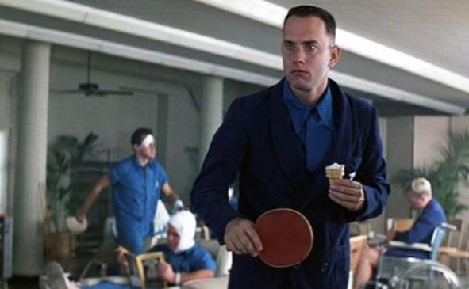
Biological Inspiration: What type of “Complexities” does the mind reduce?
Benjamin Libet’s pioneering experiments with humans:
An athlete would precisely hit a ball before being aware of that decision
Found that conscious awareness lags 200-300 milliseconds behind subconscious awareness
There’s no time for chains of reasoning/deduction when it comes to agile movements
Human’s must rely on extremely fast subconscious motor routines or these amazing feats wouldn’t be possible
Idea: Maybe this mechanism can be extend into the non-agile long-term task planning realm…
How are fast subconscious actions possible when the problems are so complex?

Slide 10
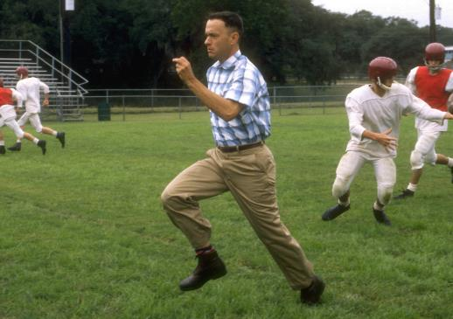
Biological Inspiration: How complex are these problems?
When we catch a ball we’re actually solving a complex set of differential equations
Wind speed, air density, mass, size, drag…
How do you catch a ball?
It’s tempting to answer with a highly-intelligent chain of reasoning
It turns out we use the “Gaze Heuristic” (Discovered by Gerd Gigerenzer):
If ignore the fact they were solving complex problem and focus on one heuristic variable we can consistently solve the problem
If the ball lowers in the sky: Run Faster
If the ball raises in the sky: Run Slower
The problem your brain solves for agile tasks:
Find simple representations of a complex problem dynamically as those problems change
The “type of complexity” that is reduced is the representation of the problem at hand, simplifying the way information flows through your controller
= Fast / Cheap Control
For slower tasks, we might merge methods
A case for the deductive tree approach:
There’s a dream that a robot could not just complete the action like a human, but could compute the optimal action at superhuman speeds.
Approach requires complex algorithms, faster sensors/processors = Costly

Slide 11
Simple Controller “Stay Upright”
Ingredients:
1) System coordinate/force transformation
2) Foot_Velocity = 3 x Center_of_Mass_Velocity
Heuristics seem to work but Is a handmade control system / representation the best approach?
Program a car to drive itself¹ on freeways = 1 month
Experience diminishing returns when trying to make it drive like a human
¹ https://medium.com/the-mission/how-to-build-a-self-driving-car-in-one-month-d52df48f5b07

Slide 12
“Where” to search for Simple Representations? Terminology:
Reduced Dimensional Representation (Example: Cartesian → Joint Space )
The human body has 244 degrees of freedom, controlled by 630 muscles
Wouldn’t want to design a system that consciously controlled 630 actuators
One type of dimensional representation may be more useful than another
Avoiding the “curse of dimensionality” arising in high-dimensional spaces
Latent Space Representation
Mathematical abstraction, not necessarily a directly observed variable
y
$${[x}_{1},y_{1},z_{1}]$$
$$\left[\begin{aligned}x_{1} \\ y_{1} \\ z_{1} \\ x_{2} \\ y_{2} \\ z_{2}\end{aligned}\right]$$
$$θ_{2}$$
$$\left[\begin{aligned}θ_{1} \\ θ_{2}\end{aligned}\right]$$
$${[x}_{2},y_{2},z_{1}]$$
$$θ_{1}$$
x
$$∇G$$
Controller Design Implications:
Inputs: Cartesian
Calculations: Continuous Latent space?
Output: Torques in Joint Space
$$\left[\begin{aligned}θ_{1} \\ θ_{2}\end{aligned}\right]$$
$$\vec{v}$$
$$\vec{v}$$

Slide 13
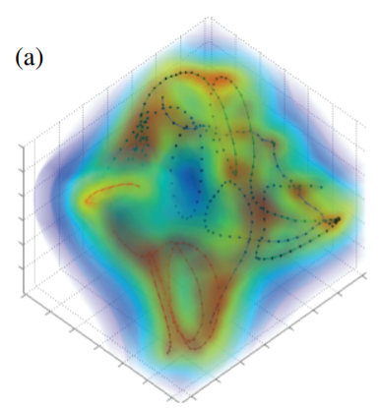
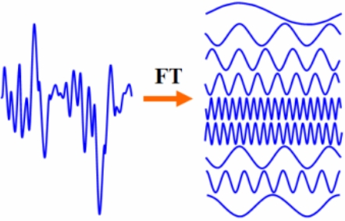
What does this transformed space look like?
Examples of System Transformations:
In rigid dynamics: Flow Fields
Infinite set mathematics:
Hilbert curves - mapping of 2d space into 1d space
Exponential mapping:
Fourier transform, taking a complicated looking system and splitting it up into a few relatively simple parts that completely describe the system
Latent Space Representation for Punching/Fighting
This can be designed by hand…
(a) “Continuous Character Control with Low-Dimensional Embeddings”, Levine,S. et al.

Slide 14
Reduced Dimensional, Latent Space Representations
The goal is to Automatically Describe a Complex Problem so that:
Lower computational load / Error contributions → Reducing the pipeline of information
Make control easy → Transform a non-linear space into continuous linear space
Easily generalizable → compact them into smooth representations, better than modules
Why does this work?
Insights from AI: Intuitive understanding of physics often means an understanding that objects follow smooth paths, moves the system closer to a “intuition” of physicality
Similar Successes: Extended Kalman Filter (pretends at linearity, instead of transforming into linearity)
How does this work? Optimize/Search given examples of desired movement:
Covariance Matrix Adaptation Evolution Strategy (CMA)
Gaussian Process Latent Variable Modeling (GPLVM)
Nearly the entire field of Bayesian statistics…
Deep Learning Neural Networks
Problems with method ( Black Box? ):
Is this system Deterministic or “Optimal”? Must we sacrifice performance for certainty?
The human brain still makes mistakes when it comes to intuition → Optical illusions
How do we get around this in order to make the robot’s deterministic/dependable/safe in a way that human brains are not? Dependent on Method.
Asimov’s 3 laws via Adversarial Networks
Slow Search Process! But smoothly generalizable.
Future: One Shot Learning

Slide 15
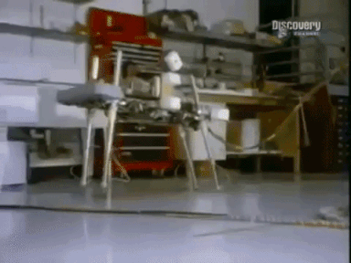
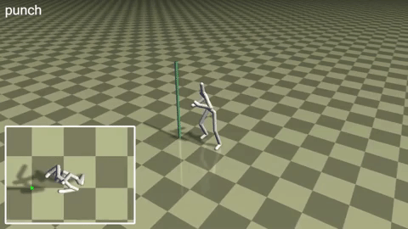
Works That use Representational/Heuristic Methods
1983 MIT's Leg Lab
Custom designed Heuristic Controllers
Still most capable / fastest dynamic balancing methods
2013 S. Levine, J. M. Wang
Learned Reduced Dimensional Latent Space Controllers

Slide 16
Software Conclusion
What’s needed Now:
Open source libraries for learning low-dimensional latent space controllers from example or exploration
The problem being solved by the controller is a lower dimensional/simpler one
Cheaper computational hardware requirements
Fewer sensors needed, less demanding sensor requirements
Smoothly generalizable form, faster and more fluid
Lowered development time cost
Future Research:
Deep learning one-shot methods are a promising avenues to develop fast “muscle memory” like intuitions
Extending this approach to large time scale tasks
Far Future:
Merging with deductive knowledge based systems
Asimov’s Three Laws via Adversarial Networks?
Extend approach to transform system into a compact Riccatti time-variant form for deterministic optimal control

Slide 17
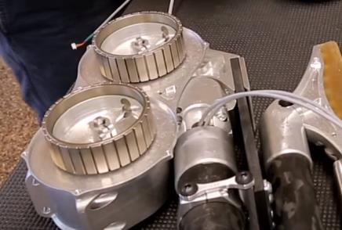
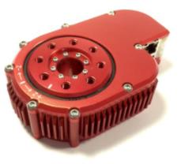
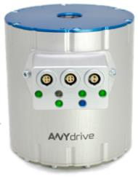
Hardware
Video Game’s Popularity lead towards huge advancements in GPUs
Quadcopter’s popularity lead towards cheaper brushless motors, integrated/miniaturized flight controllers
The same needs to be done for Torque/Force Controlled systems:
Control Techniques:
Active Impedance, Stiffness
Torque Control vs. Velocity Control
Efficiency:
Hardware optimization: Regenerative Breaking
Software optimization: Towards Optimal Control for the System
Actuator Choice:
Hydraulics
Custom high torque brushless gimbal motors
Artificial Muscles
Fast Direct Drive vs. Semi-Direct Drive vs. Fast update rate torque sensors in geared systems
Low Hanging Fruit:
Actuator cost reduction and capability increase (piggyback off of quadcopters, but add IC torque control)
Miniaturized Systems for research/development
(smaller → cheaper)
Software Advancements (open source libraries)
Cassie (Agility Robotics) Custom brushless motors
HEBI Robotics Actuator
ANYdrive Actuator

Slide 18
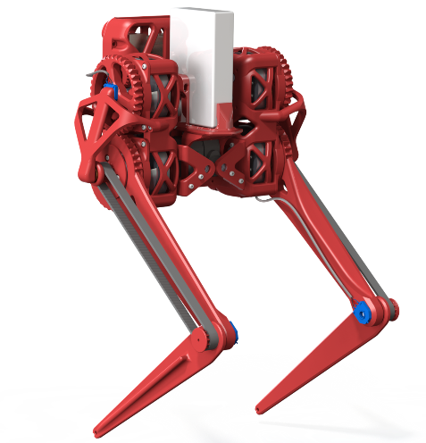
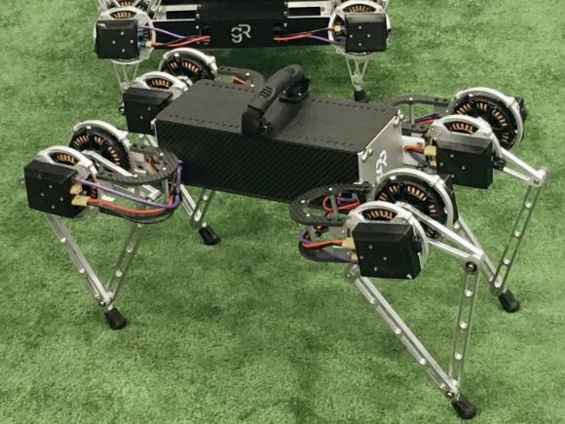
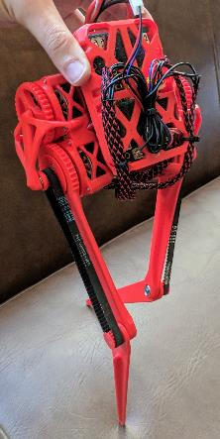
Any Questions?
2017 Ghost Minitaur: Ghost Robotics
2017 BIP 1: Darren Levine

